Slide 1




Redesigning Partnerships to Build Workforce Pipelines for the Future
CEO THINK TANK WEBINAR
1

Slide 2
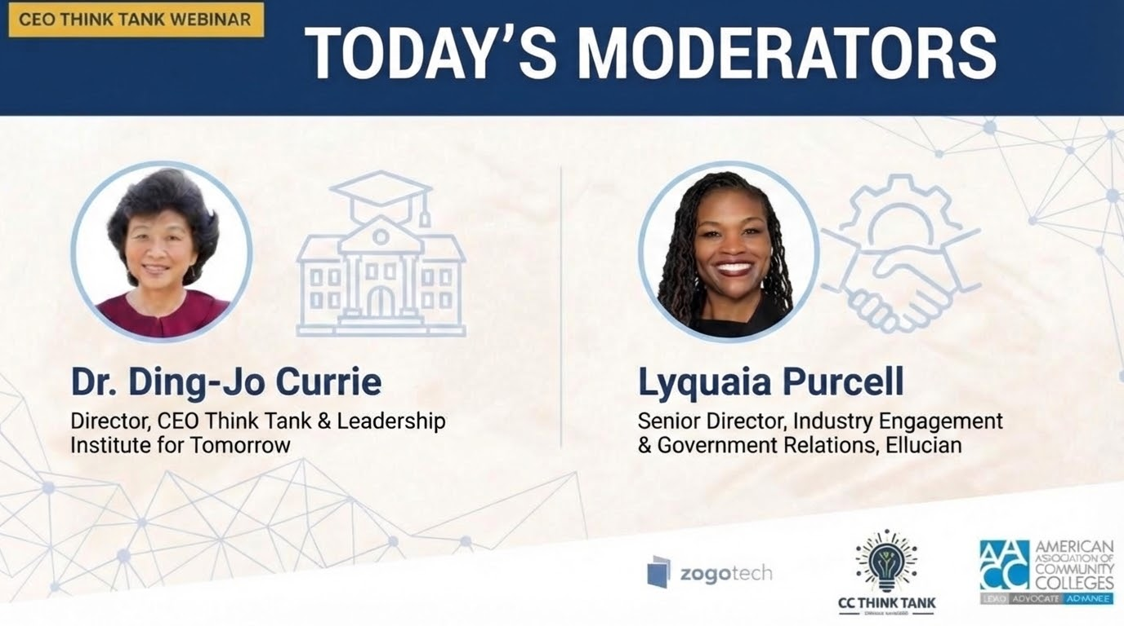

Slide 3
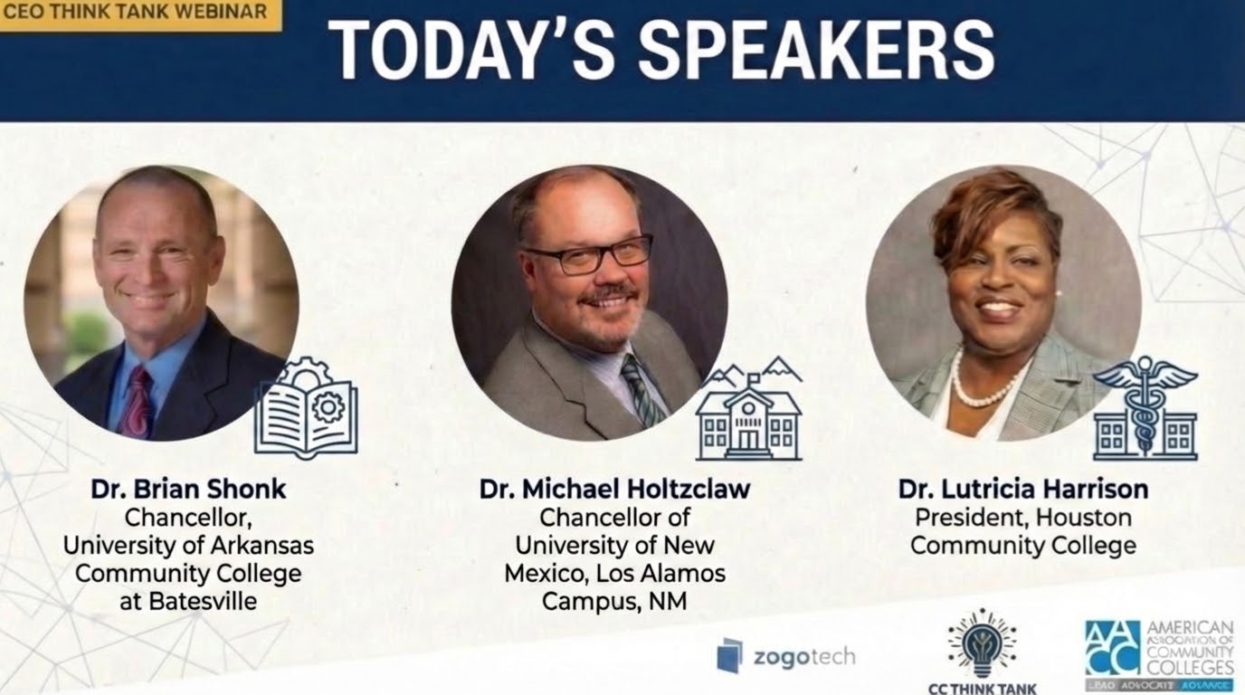

Slide 4
