Slide 1


Using Technical Content to Teach Non-Technical Workforce Skills
Deb Newberry dmnewberry2001@yahoo.com

Slide 2
Nano-Link
Center for Nanotechnology Education
An alliance of 14 schools throughout the US
Lead Institution:
Dakota County Technical College
Rosemount, MN
Started a nano program in 2004
Stop by booth 607/608 at the Showcase tonight to learn more

Slide 3

Dakota County Technical College
Nanoscience Technology Program Course Outline and Credit Allocation
rev. 2011
Semester 1 at DCTC |  |  | Semester 2 at DCTC |  |  | Semester 3 at DCTC |  |  | Semester 4 At Univ. of MN
Course | Name | Credits | Course | Name | Credits | Course | Name | Credits | Course | Name | Credits
BIOL 1500 | General Biology | 4 | CHEM 1500 | Introduction to Chemistry | 4 | NANO 2101 | Nano Electronics | 3 | MT 3111 | Elem. of Micro Manufacturing | 3
PHYS 1100 | College Physics I | 4 | PHYS 1200 | College Physics II | 4 | NANO 2111 | Nanobiotechnology/ Agriculture | 3 | MT 3112 | Elem. of Micro Mfg Lab | 1
ENGL 1100 | Writing & Research Skills | 3 | SPEE 1020 | Interpersonal Communication | 3 | NANO 2121 | Nanomaterials | 3 | MT 3121 | Thin Films Deposition | 3
MATS 1300 | College Algebra | 4 | MATS 1250 | Principles of Statistical Analysis | 4 | NANO 2131 | Manufacturing, Quality Assurance | 2 | MT 3131 | Intro to Materials Characterization | 3
NANO 1100 | Fund. of Nano I | 3 | NANO 1200 | Fund of Nano II | 3 | NANO 2140 | Interdisciplinary Lab | 3 | MT 3132 | Materials Characterization Lab | 1
 |  |  | NANO 1210 | Computer Simulation | 1 | NANO 2151 | Career Planning and Industry | 1 | MT 3141 | Principles and Applications of Bionanotechnology | 3
 |  |  | NANO 1222 | Student Lab Experience and Research | 3 |  |  |  | MT 3142 | Nanoparticles & Biotechnology Lab | 1
 |  |  |  |  |  |  |  |  | NANO 2970 | Internship | 2
Credits |  | 18 | Credits |  | 19 | Credits |  | 15 | Credits |  | 17
Knowledge transfer
And
Concept Integration

Slide 4
Dakota County Technical College
Nanoscience Technology Program Course Outline and Credit Allocation
rev. 2011
Semester 1 at DCTC |  |  | Semester 2 at DCTC |  |  | Semester 3 at DCTC |  |  | Semester 4 At Univ. of MN
Course | Name | Credits | Course | Name | Credits | Course | Name | Credits | Course | Name | Credits
BIOL 1500 | General Biology | 4 | CHEM 1500 | Introduction to Chemistry | 4 | NANO 2101 | Nano Electronics | 3 | MT 3111 | Elem. of Micro Manufacturing | 3
PHYS 1100 | College Physics I | 4 | PHYS 1200 | College Physics II | 4 | NANO 2111 | Nanobiotechnology/ Agriculture | 3 | MT 3112 | Elem. of Micro Mfg Lab | 1
ENGL 1100 | Writing & Research Skills | 3 | SPEE 1020 | Interpersonal Communication | 3 | NANO 2121 | Nanomaterials | 3 | MT 3121 | Thin Films Deposition | 3
MATS 1300 | College Algebra | 4 | MATS 1250 | Principles of Statistical Analysis | 4 | NANO 2131 | Manufacturing, Quality Assurance | 2 | MT 3131 | Intro to Materials Characterization | 3
NANO 1100 | Fund. of Nano I | 3 | NANO 1200 | Fund of Nano II | 3 | NANO 2140 | Interdisciplinary Lab | 3 | MT 3132 | Materials Characterization Lab | 1
 |  |  | NANO 1210 | Computer Simulation | 1 | NANO 2151 | Career Planning and Industry | 1 | MT 3141 | Principles and Applications of Bionanotechnology | 3
 |  |  | NANO 1222 | Student Lab Experience and Research | 3 |  |  |  | MT 3142 | Nanoparticles & Biotechnology Lab | 1
 |  |  |  |  |  |  |  |  | NANO 2970 | Internship | 2
Credits |  | 18 | Credits |  | 19 | Credits |  | 15 | Credits |  | 17
Critical Thinking,
Problem Solving,
“Does this answer make sense?”
Throughout all courses

Slide 5
Dakota County Technical College
Nanoscience Technology Program Course Outline and Credit Allocation
rev. 2011
Semester 1 at DCTC |  |  | Semester 2 at DCTC |  |  | Semester 3 at DCTC |  |  | Semester 4 At Univ. of MN
Course | Name | Credits | Course | Name | Credits | Course | Name | Credits | Course | Name | Credits
BIOL 1500 | General Biology | 4 | CHEM 1500 | Introduction to Chemistry | 4 | NANO 2101 | Nano Electronics | 3 | MT 3111 | Elem. of Micro Manufacturing | 3
PHYS 1100 | College Physics I | 4 | PHYS 1200 | College Physics II | 4 | NANO 2111 | Nanobiotechnology/ Agriculture | 3 | MT 3112 | Elem. of Micro Mfg Lab | 1
ENGL 1100 | Writing & Research Skills | 3 | SPEE 1020 | Interpersonal Communication | 3 | NANO 2121 | Nanomaterials | 3 | MT 3121 | Thin Films Deposition | 3
MATS 1300 | College Algebra | 4 | MATS 1250 | Principles of Statistical Analysis | 4 | NANO 2131 | Manufacturing, Quality Assurance | 2 | MT 3131 | Intro to Materials Characterization | 3
NANO 1100 | Fund. of Nano I | 3 | NANO 1200 | Fund of Nano II | 3 | NANO 2140 | Interdisciplinary Lab | 3 | MT 3132 | Materials Characterization Lab | 1
 |  |  | NANO 1210 | Computer Simulation | 1 | NANO 2151 | Career Planning and Industry | 1 | MT 3141 | Principles and Applications of Bionanotechnology | 3
 |  |  | NANO 1222 | Student Lab Experience and Research | 3 |  |  |  | MT 3142 | Nanoparticles & Biotechnology Lab | 1
 |  |  |  |  |  |  |  |  | NANO 2970 | Internship | 2
Credits |  | 18 | Credits |  | 19 | Credits |  | 15 | Credits |  | 17
Overt and
Covert
Assumptions

Slide 6
Dakota County Technical College
Nanoscience Technology Program Course Outline and Credit Allocation
rev. 2011
Semester 1 at DCTC |  |  | Semester 2 at DCTC |  |  | Semester 3 at DCTC |  |  | Semester 4 At Univ. of MN
Course | Name | Credits | Course | Name | Credits | Course | Name | Credits | Course | Name | Credits
BIOL 1500 | General Biology | 4 | CHEM 1500 | Introduction to Chemistry | 4 | NANO 2101 | Nano Electronics | 3 | MT 3111 | Elem. of Micro Manufacturing | 3
PHYS 1100 | College Physics I | 4 | PHYS 1200 | College Physics II | 4 | NANO 2111 | Nanobiotechnology/ Agriculture | 3 | MT 3112 | Elem. of Micro Mfg Lab | 1
ENGL 1100 | Writing & Research Skills | 3 | SPEE 1020 | Interpersonal Communication | 3 | NANO 2121 | Nanomaterials | 3 | MT 3121 | Thin Films Deposition | 3
MATS 1300 | College Algebra | 4 | MATS 1250 | Principles of Statistical Analysis | 4 | NANO 2131 | Manufacturing, Quality Assurance | 2 | MT 3131 | Intro to Materials Characterization | 3
NANO 1100 | Fund. of Nano I | 3 | NANO 1200 | Fund of Nano II | 3 | NANO 2140 | Interdisciplinary Lab | 3 | MT 3132 | Materials Characterization Lab | 1
 |  |  | NANO 1210 | Computer Simulation | 1 | NANO 2151 | Career Planning and Industry | 1 | MT 3141 | Principles and Applications of Bionanotechnology | 3
 |  |  | NANO 1222 | Student Lab Experience and Research | 3 |  |  |  | MT 3142 | Nanoparticles & Biotechnology Lab | 1
 |  |  |  |  |  |  |  |  | NANO 2970 | Internship | 2
Credits |  | 18 | Credits |  | 19 | Credits |  | 15 | Credits |  | 17
Experiment
Observe
Document
Ponder

Slide 7
Undergraduate Research
Impetus – Give students strong examples for their portfoios
  Did not require expensive or extensive equipment
  Related to nanoscience in a strong way and included a combination of multiple disciplines
  Wanted a longer term project – not just a 1 or 2 semester activity
Dual use
  Teach technical skills, techniques and concepts
  Teach “21st Century skills”: Critical thinking, problem solving, planning complex projects, program management, teamwork, time management
Selected TiO2 nanoparticle impact on freshwater bi-valve mollusks – based on PhD work by John Doyle
  Start – August 2017
  Currently 4 students
  Reading and prepatory work completed
  Establishing schedule, detailed tasks, interdependencies, materials, related work (lit search)

Slide 8
Project Outline: Part 1
Purpose: To understand how suspension-feeding bivalves respond to an anthropogenic contaminant in a freshwater system
Target species: Zebra mussel (Dreissena polymorpha); invasive species common in freshwater systems in Minnesota
Contaminant: Titanium dioxide nanoparticles
Part I of the study: Characterization of water and nanoparticles

Slide 9
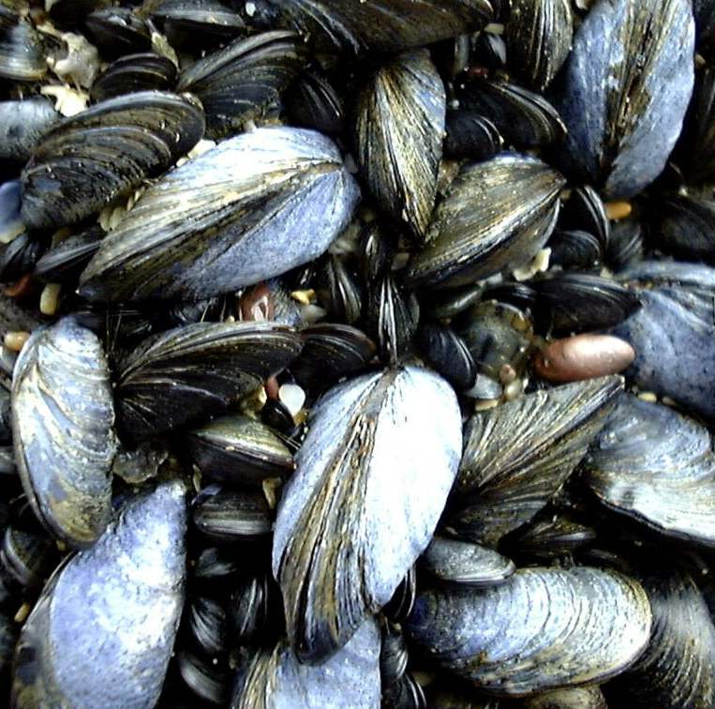
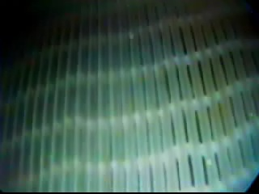
Why Suspension-Feeding Bivalves?
Initial studies were performed on the Blue Mussel (Mytilus edulis)
Bivalves cannot capture individual nanoparticles
In marine aggregates, nanoparticles become more bioavailable
Will the same effect be observed in a freshwater system?
www.nematodes.org/NeglectedGenomes/MOLLUSCA/MEC.jpg

Slide 10
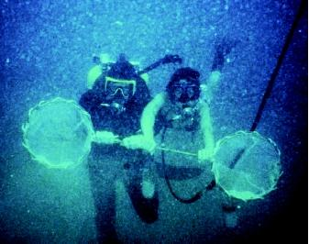
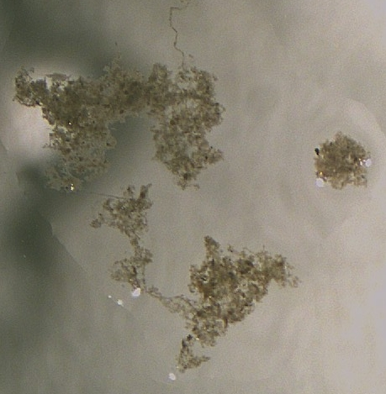
What are Aggregates?
Aggregations of inorganic and organic matter
Result of collision and adhesion forces
Biologically secreted mucopolysaccharides
www.waterencyclopedia.com/images/wsci_03_img0374.jpg
1 mm
Notes:
Shear, Brownian motion, differential settling

Slide 11
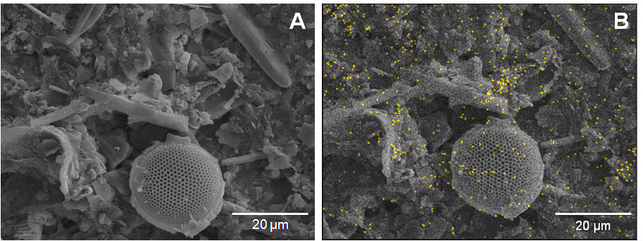
Nanoparticles in Aggregates
Scanning Electron Micrographs
> 100 nm TiO₂
3 days;
ca. 65 % NP incorporation
X-ray map of image shown in “A” (EDX)
Gold = Ti
10 um
ca. 40 nm TiO₂
d

Slide 12
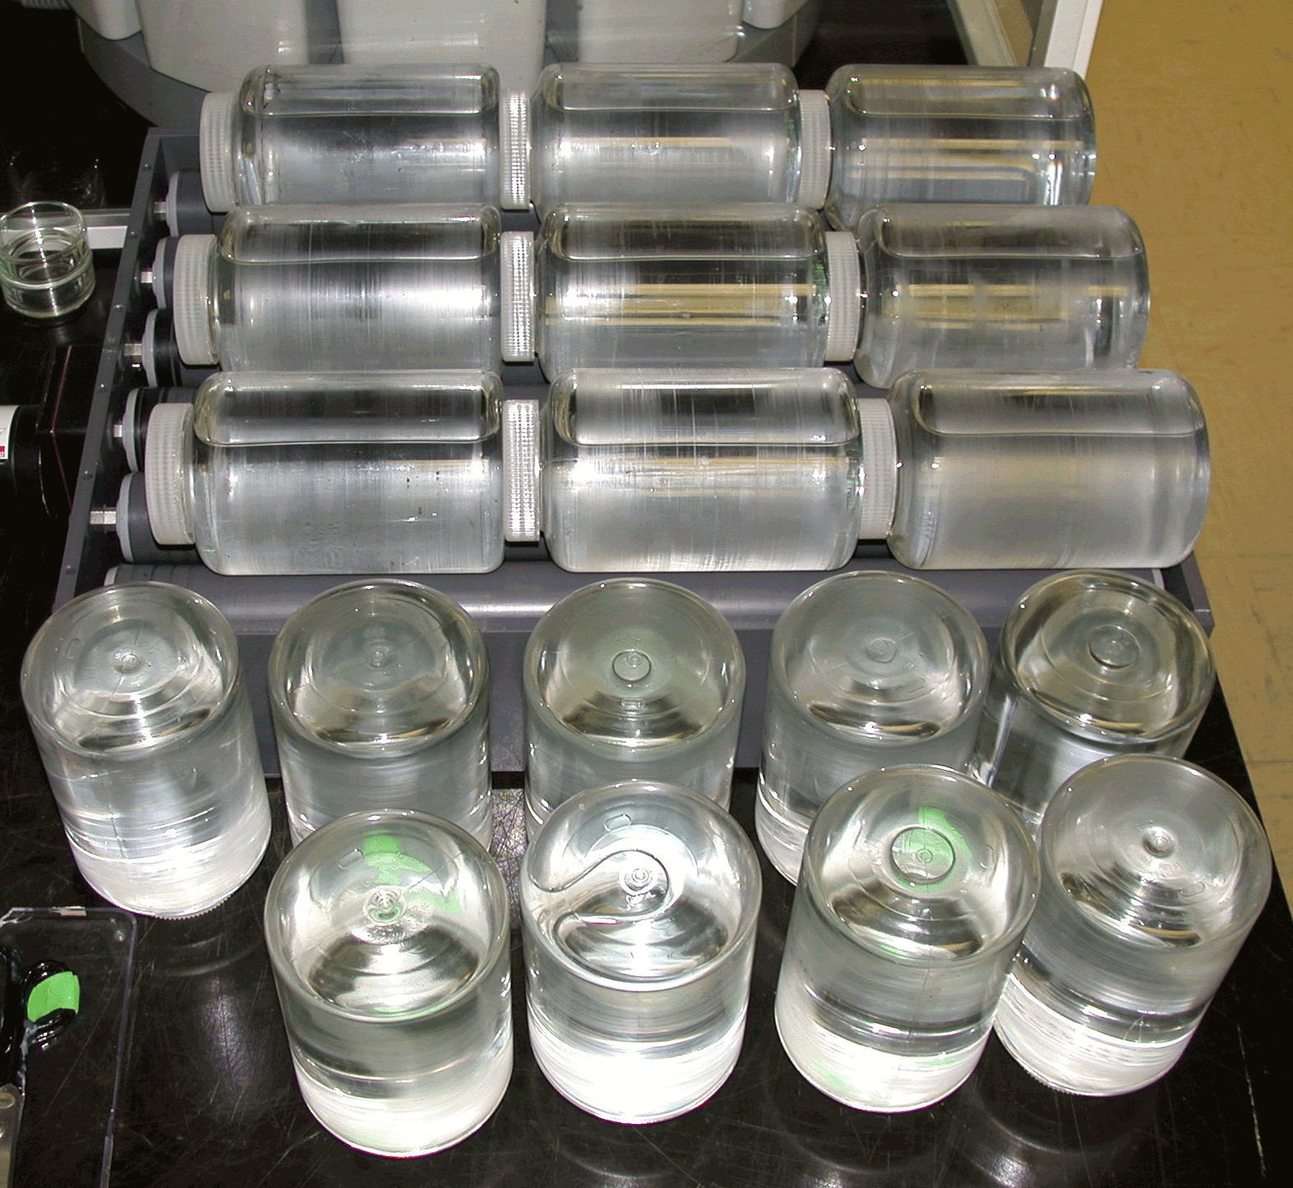
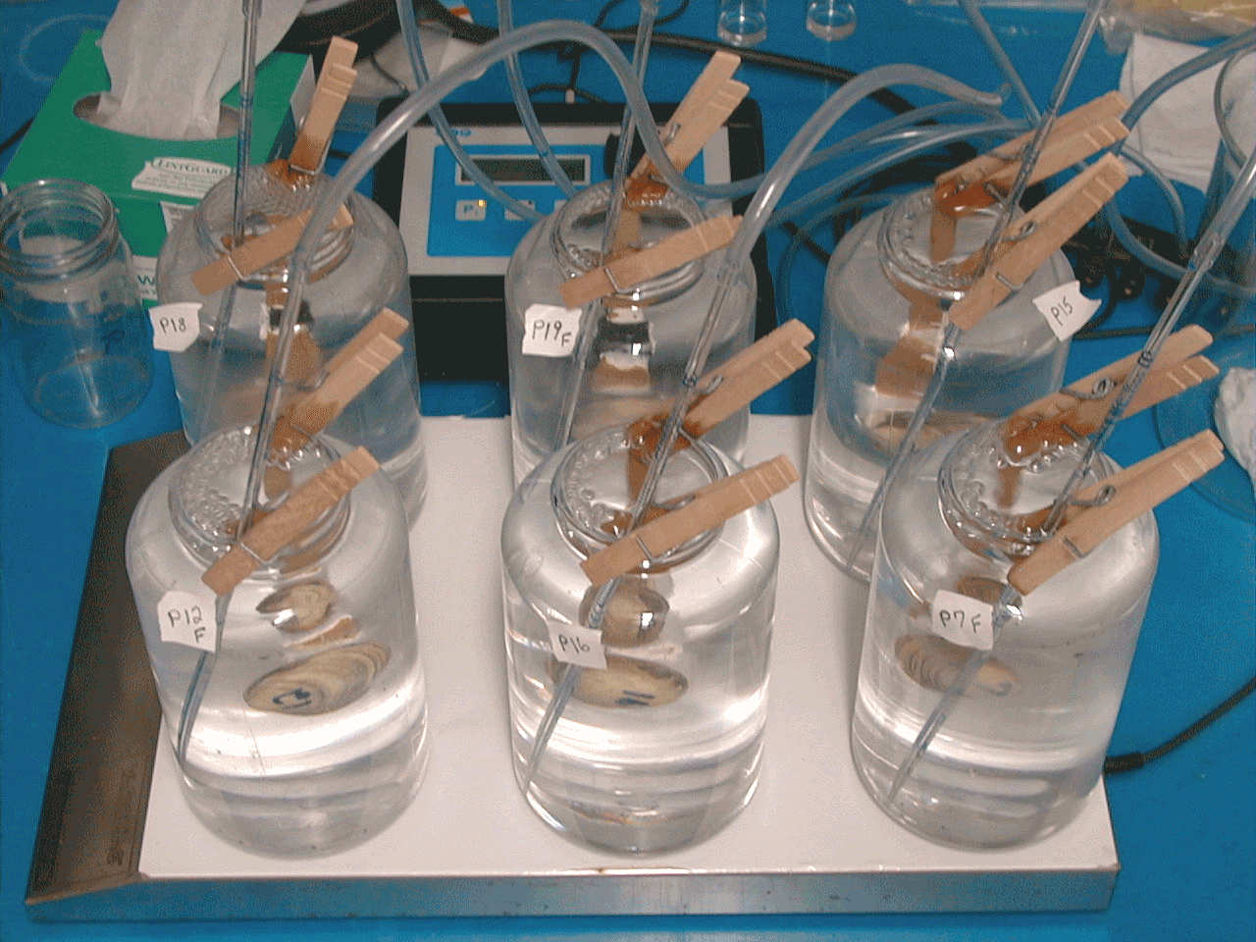
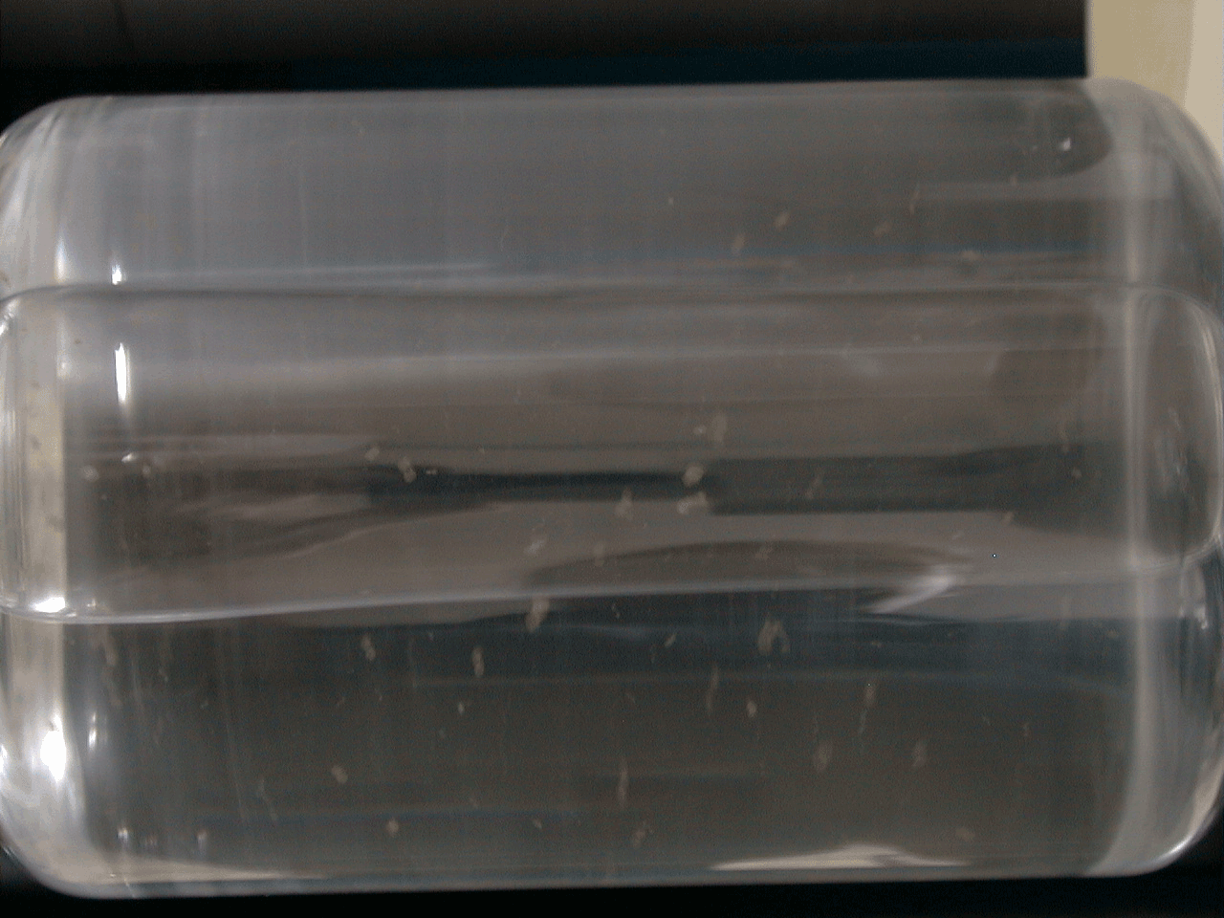
Incorporation Study
NP suspension prepared
  Freshwater
  TiO₂ NP (rutile, ca. 40 nm, ca. 1 ppm)
Laboratory aggregates generated

Slide 13
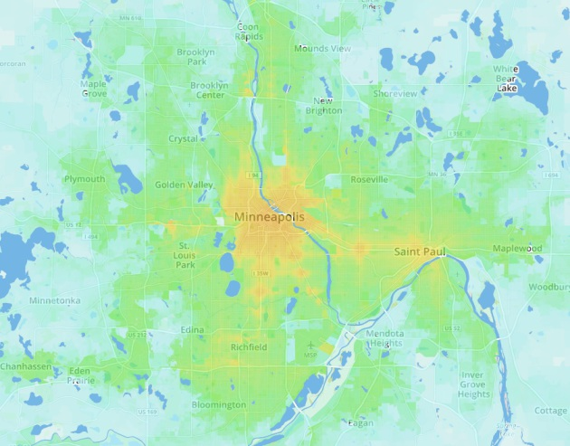

Slide 14
Planning
TASKS
Develop overall project plan
Define mission
Define tasks and schedule
Research: Zebra mussels and location
Research, review and study previous
fresh water work
Define water collection sites
Order materials
TECHNICAL
Learn program management SW
Create and understand Gantt charts
Evaluate interdependencies of tasks
Develop process flow charts
Learn new vocabulary (and use it)
NON TECHNICAL
Learn teamwork
Assess individual and group strengths
and weaknesses
Practice communication (oral and written (graphing)

Slide 15
Water and NP Characterization
TASKS
Learn container preparation
Define and practice collection methodology
Document collection location and other data
Determine properties and measurement approach
Determine instruments required
Learn instrument operation
Measure and evaluate water properties
Assess tolerance values
Test and characterize nanoparticles
Define aggregates and process
TECHNICAL
Understand properties to be measured
In water - pH, chemical composition, total suspended solids, dissolved organic carbon
In nanoparticles - Surface area, zeta potential, hydrodynamic diameter, crystalline structure
Understand and calculate tolerance allowances, statistical variation, equipment accuracy
NON TECHNICAL
Appropriate documentation and data collection
Optimize data presentation and interpretation
Practice critical thinking
Practice problem solving
Develop time management skills

Slide 16
Animal Testing
TASKS
Order and inspect animals (or collect?)
Define and practice protocol
Run pilot set of animals
Generate laboratory aggregates
Determine schedule for activity
Perform Experiments
Document results
Analyze data
Create research paper
TECHNICAL
Define protocol for inspections
Practice good lab procedure
Define data collection
Perform data analysis
Consider statistical variation
Evaluate data - results
NON TECHNICAL
Learn complex lab procedure
Plan data collection
Learn various ways of presenting data
Practice team work
Communication – writing a research paper
Analyze data
Problem solving

